Slide 1
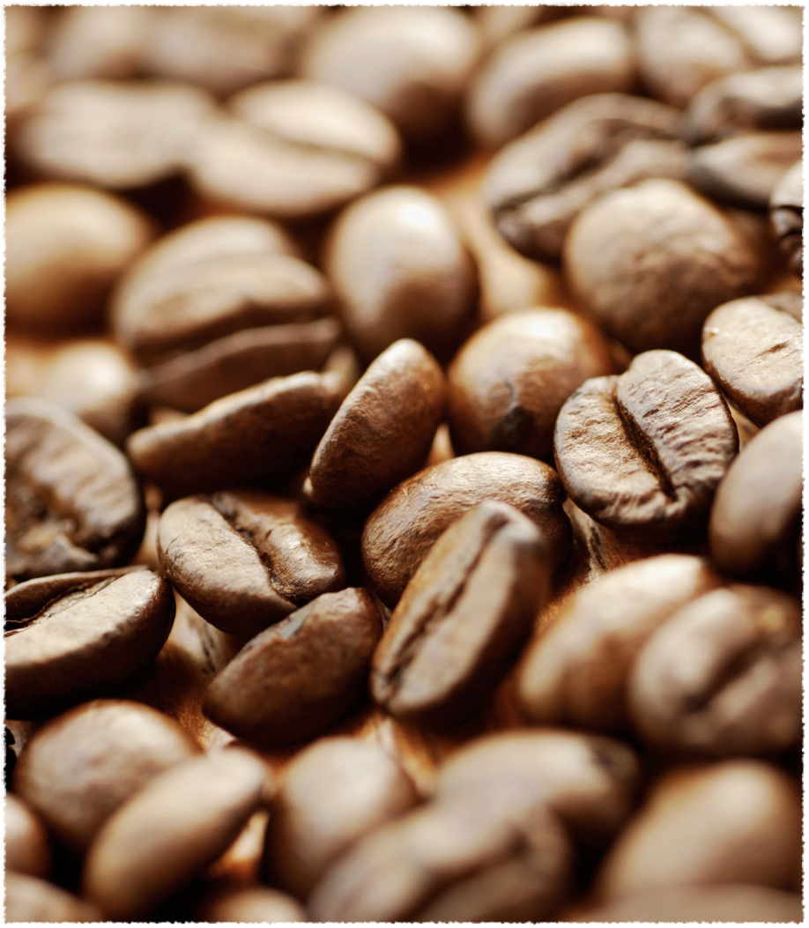
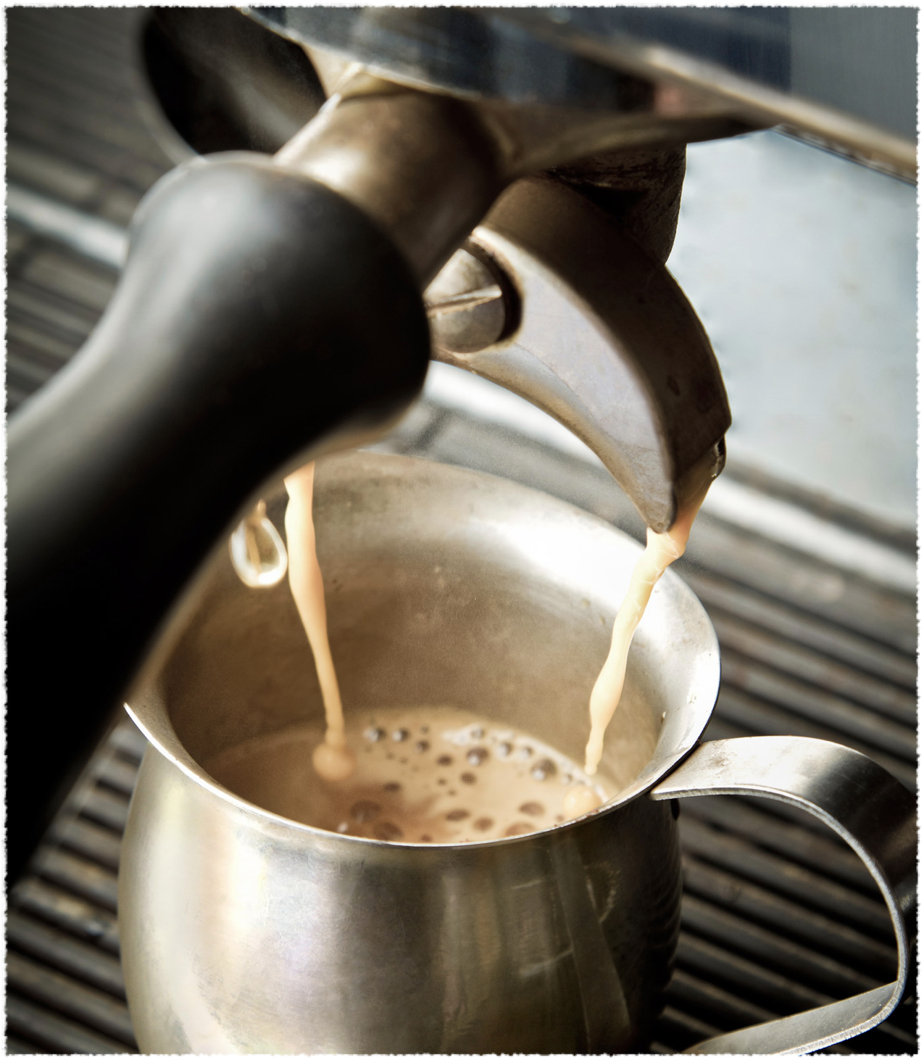
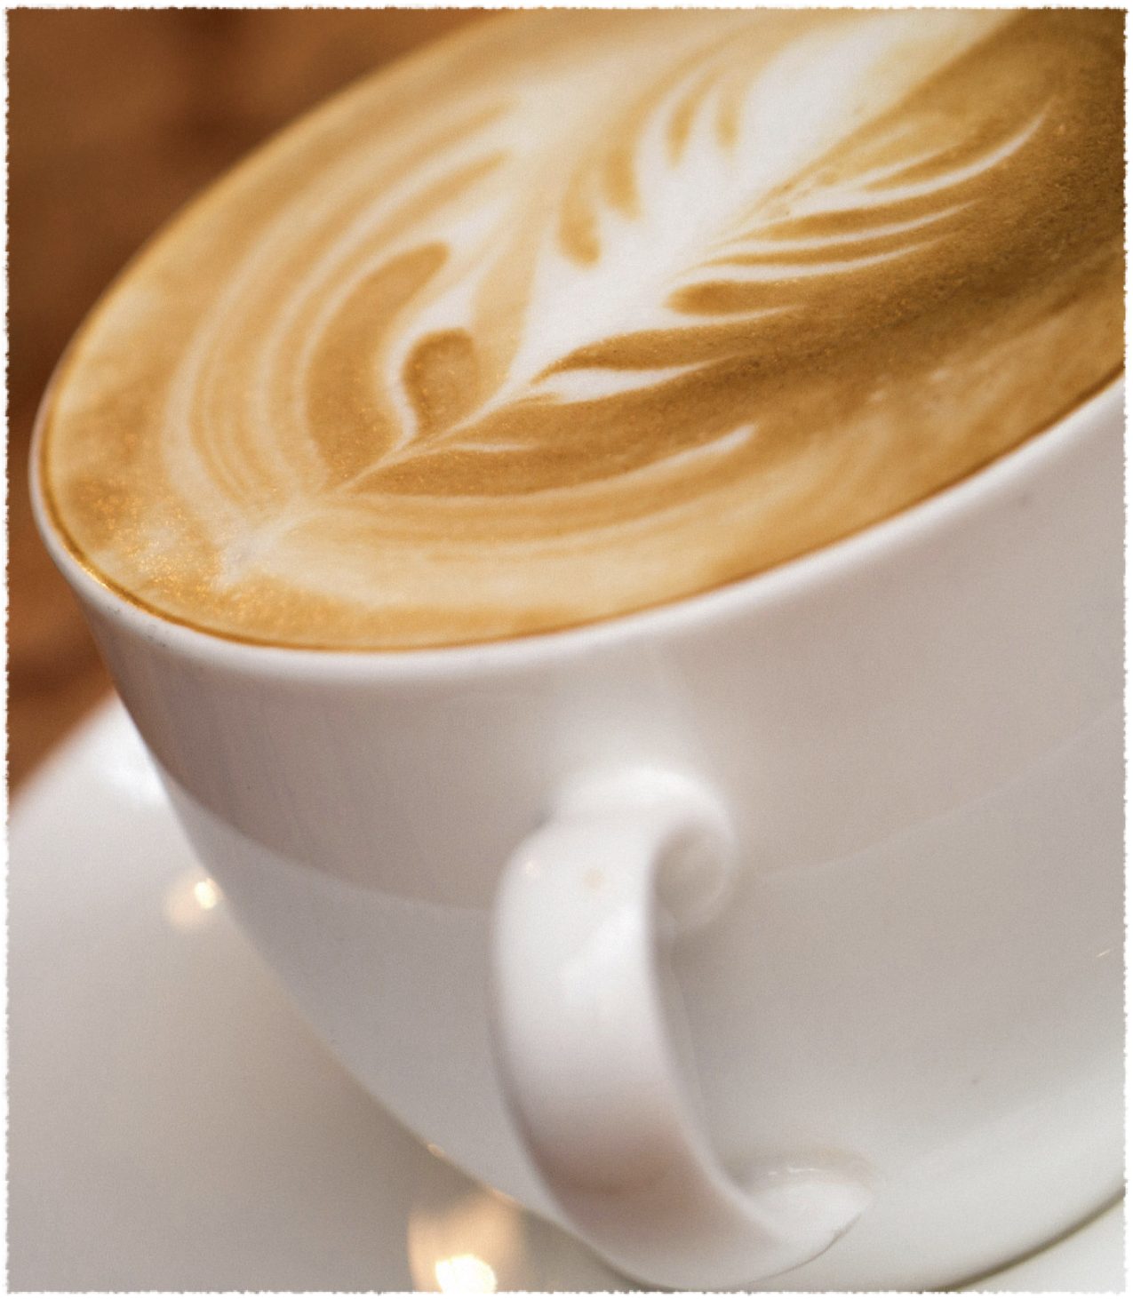
Saga Orchestration
Using MassTransit*

Slide 2
Event Driven Architecture
EDA is a software architecture paradigm concerning the production and detection of events.
An event-driven system typically consists of:
Event emitters
Event consumers
Event channels

Slide 3
Sagas
A saga is a design pattern used in EDA to manage long-running transactions that span multiple services / events.
There are 2 ways of coordinating sagas:
Choreography
Orchestration

Slide 4
The coffee bar
Let’s do it!

Slide 5
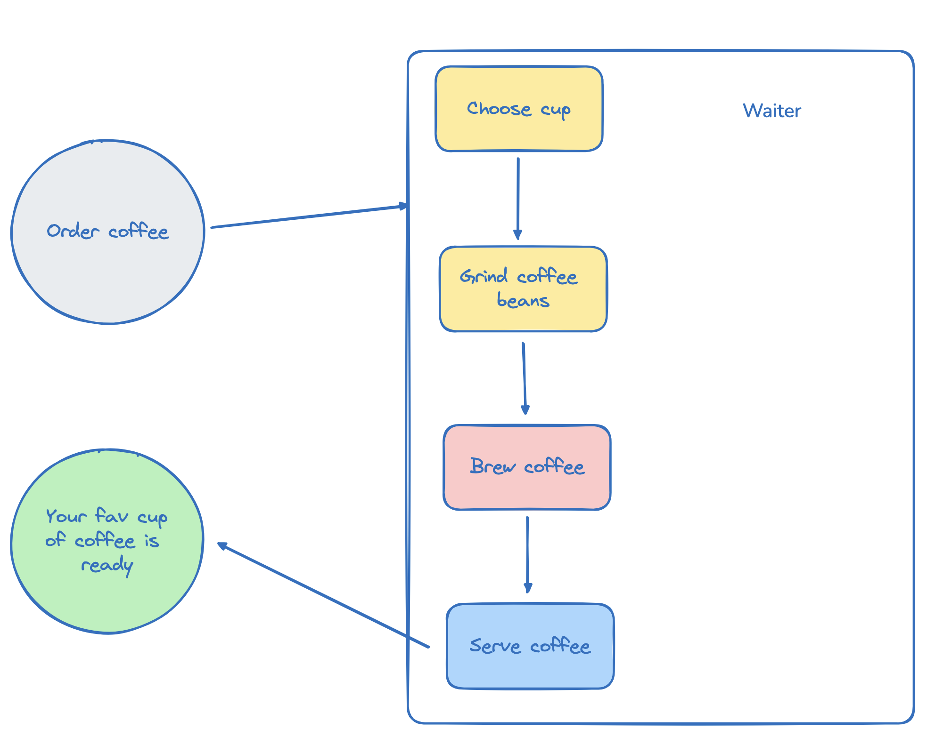
The coffee bar

Slide 6
We wants this to scale

Slide 7
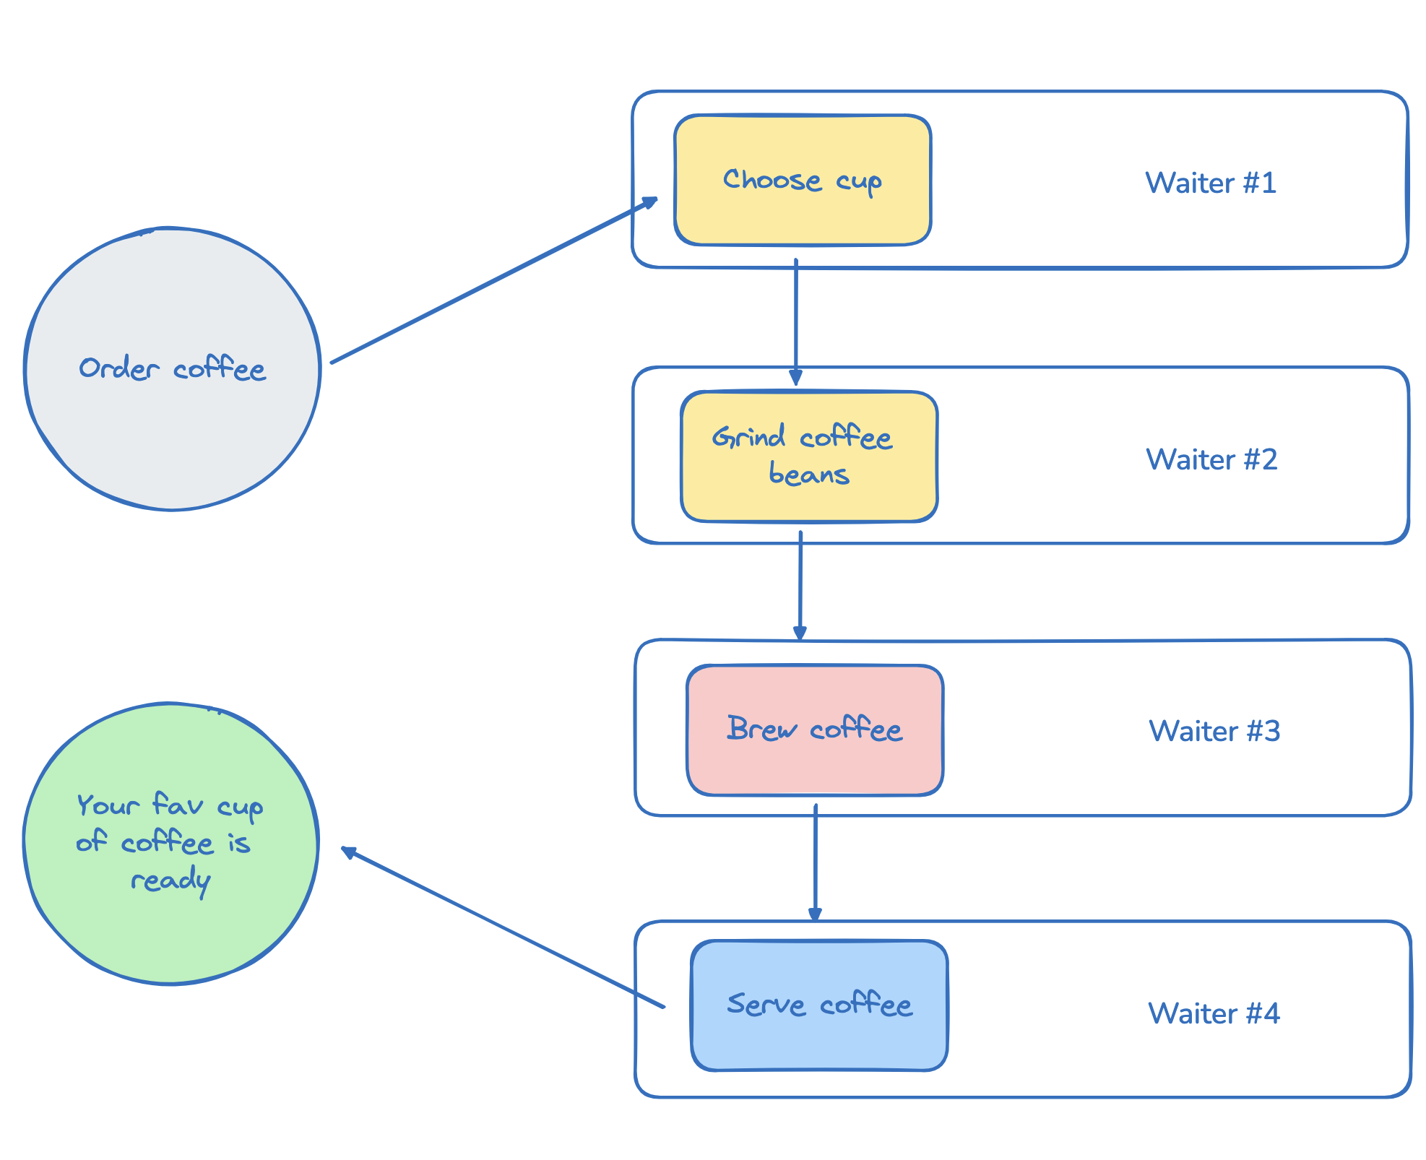
The coffee bar

Slide 8

The coffee bar
Voice
Voice = request / response (http or others)
Waiters = microservices
Voice
Voice
Voice
Voice

Slide 9
The coffee bar
Note
Note = message / event
Waiters = microservices
Note
Note
Note
Note
CHOREOGRAPHY

Slide 10
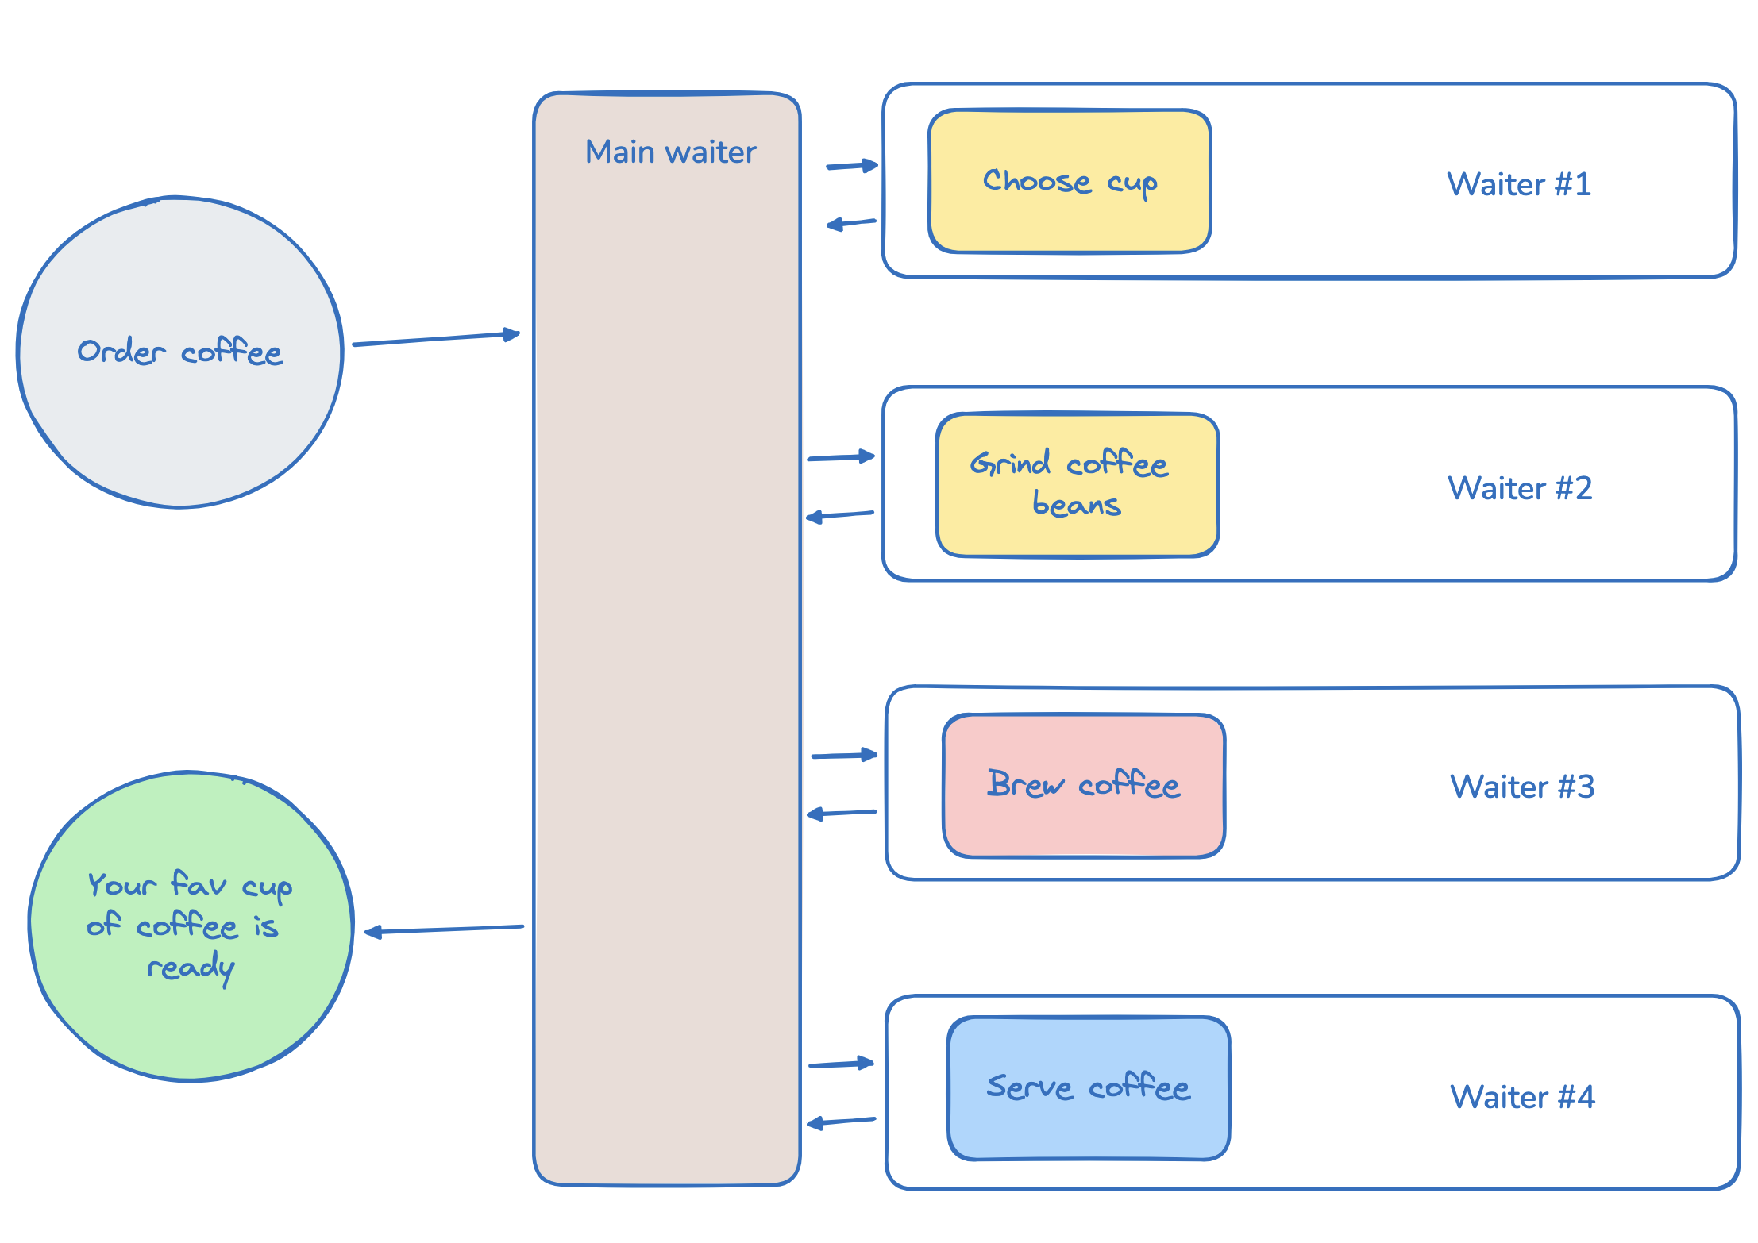
The coffee
bar
Notes
Note
Notes
Notes
Note
Notes
ORCHESTRATOR

Slide 11
MassTransit
Messaging framework for .NET
Facilitates communication between applications following EDA
Support multiple message brokers (Azure Service Bus, RabbitMQ, etc…)
Implements multiple patterns (ie Sagas)

Slide 12
Code demo

